Slide 1
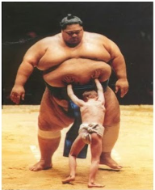
Feature Scaling
-Aishwarya Madan.Borkar
1

Slide 2
What is feature scaling?
Feature Scaling is a method to normalize the range of independent variables.
By normalizing we mean to give equal weightage,equal importance to ll the features in the dataset.
There are various techniques for scaling our dataset Rescaling, Mean normalization and Standardization(z-score normalization).
2

Slide 3
What is Normalization?
The term “normalization” refers to the scaling down of the data set such that the normalized data falls between 0 and 1. This normalization technique helps compare corresponding normalized values from two or more data sets.
It eliminates the effects of the variation in the scale of the data sets, i.e., a data set with large values can be easily compared with a data set with smaller values.
3

Slide 4
What is the use of Normalization?
The short answer is it improves the model accuracy.
In simple words,it gives equal weights/importance so that no bigger numbers are dominant and smaller numbers are recessive.
So how to implement it?
4

Slide 5
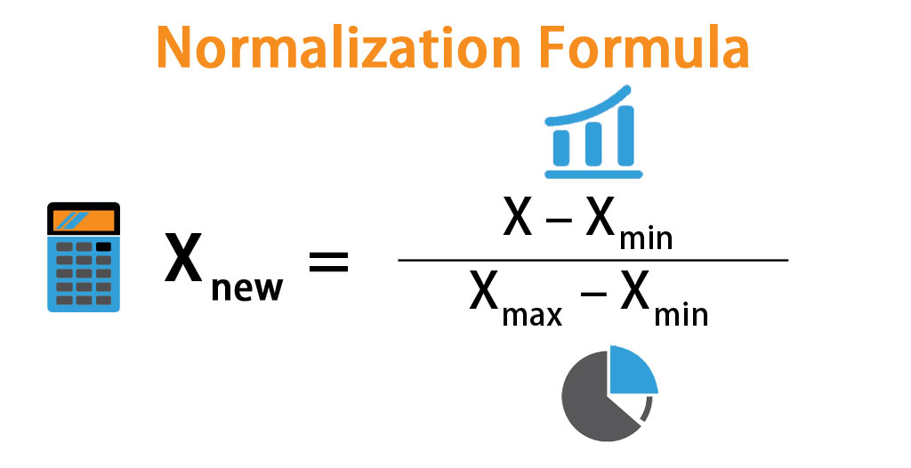
5

Slide 6
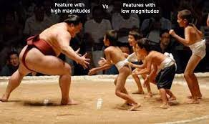
So it is better to give justice to all the variables in our dataset while analysis to avoid errors and bias.
THANK YOU

